Slide 1
Heat Transfer

Slide 2
The first law of thermodynamics is also called the law of conservation of energy. It states that energy can be transferred from one system to another, but it cannot be destroyed.
This means that whenever we heat something up, the energy has to have come from somewhere.

Slide 3
Convection
Convection is the transfer of heat energy by the bulk movement of particles.
Particles flow from warmer regions to cooler regions and take thermal energy with them.
Due to the need for particles to move, this occurs only in liquids and gases.

Slide 4
Hotter portions of a substance are less dense than cooler portions, so will rise.
The cooler portions will flow down due to their higher density.
In the example on the right, this causes a convection cell to form.
Image from. https://commons.wikimedia.org/wiki/File:Convection.gif

Slide 6
Conduction
Conduction is the transfer of heat between substances that are in contact.
When a substance is heated, its particles gain more energy and move more. These particles bump into nearby particles and transfer some of their energy.
This then continues and passes the energy from the hot end down to the colder end of the substance.

Slide 7
Image from: http://ignitionpack.ca/files/panoramas/bam/types-of-heat-transfer.php

Slide 8
Radiation
Heat transfer when there is no contact between the heating and heated substances is known as radiation.
Energy from the source travels in waves. The radiation energy causes particles in the substance it hits to move quickly, gaining kinetic energy and therefore temperature.
Examples include the heat we feel from the sun, the heat we get from sitting next to a fire…..

Slide 9
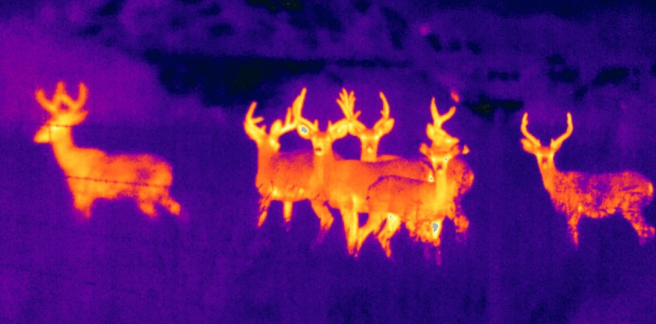
Thermal imaging relies on radiation from the source reaching the camera. The temperature of the object is greater than the surrounds, so heat radiates out. The camera detects this heat in infrared wavelengths.
A signal-processing unit then displays this as various colours depending on the intensity of the infrared radiation detected.

Slide 10
Image from http://ignitionpack.ca/files/panoramas/bam/types-of-heat-transfer.php

